Slide 1
TOURISM
WEB
submitted by:
SAMYAK JAIN-11710340
JAYANTH-11710401
MOHAN-11710844
CHANDAN K YADAV-1170391
Notes:
Darkened picture background with full-color circle
(Intermediate)
Tip: For best results with the picture overlay on this slide, use a picture that is the same dimensions as the slide: 10” wide and 7.5” high. If the picture is not the same width and height, resize or crop to those dimensions before following the instructions below.
To reproduce the background effects on this slide, do the following:
On the Home tab, in the Slides group, click Layout, and then click Blank.
Right-click the slide and then click Format Background.
In the Format Background dialog box, click Fill in the left pane. In the Fill pane, select Picture or texture fill, and then under Insert from, click File.
In the Insert Picture dialog box, select a picture, and then click Insert.
Also in the Format Background dialog box, click Picture in the left pane, and then do the following in the Picture pane:
Click the button next to Recolor, and then under Color Modes, click Grayscale (first option from the left).
In the Brightness box, enter -50%.
In the Contrast box, enter -60%.
On the Insert tab, in the Images group, click Picture.
In the Insert Picture dialog box, select the same picture used for the background, and then click Insert.
On the Home tab, in the Drawing group, click Shape Effects, point to Soft Edges, and then click 10 Point.
Under Picture Tools, on the Format tab, in the Size group, click the down arrow under Crop, click Crop to Shape, and then under Basic Shapes, click Oval (first row, first option from the left).
Select the oval. Under Picture Tools, on the Format tab, in the bottom right corner of the Size group, click the Size and Position dialog box launcher. In the Size and Position dialog box, on the Size tab, under Crop from, enter values into the Left, Right, Top, and Bottom boxes to crop the oval as needed.

Slide 2
LIST OF SLIDES:
About the project
Objectives
Technologies we used
Front page of our website
Sign up page
Login page
Best offers
Team members
Contact us
conclusion

Slide 3
ABOUT THE PROJECT
Dynamic and competitive industry.
Upgrade with the time to fulfil with customers needs and desires.
Outbound Tourism
Inbound Tourism
Domestic Tourism

Slide 4
OBJECTIVES
To done with customer’s satisfaction, safety and enjoyment.
To provide:
Transportation
Travel services recreation
Entertainment
Accommodation
Food and beverage services.

Slide 5
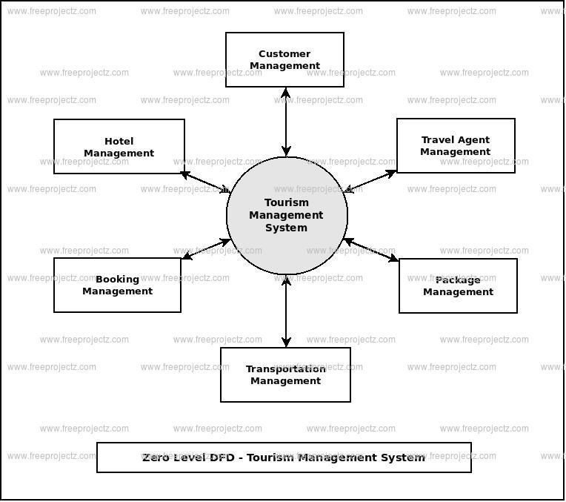
FLOW CHART FOR TOURISM WEB

Slide 6
TECHNOLOGIES WE USED
HTML 5
CSS
JAVA SCRIPT
Platform used:
Mac OS 10.12
Windows 10
NOTEPAD
SUBLIME

Slide 7
WORK DIVISION AMONG US:
SAMYAK JAIN:
~Appendix
~Front Page
~Sign Up page
B .JAYANTH:
~Log in page
~Best offers page
Mohan:
~Team members
~Contact Us page
Chandan k Yadav:
~SWOT analysis
~Forget password

Slide 8
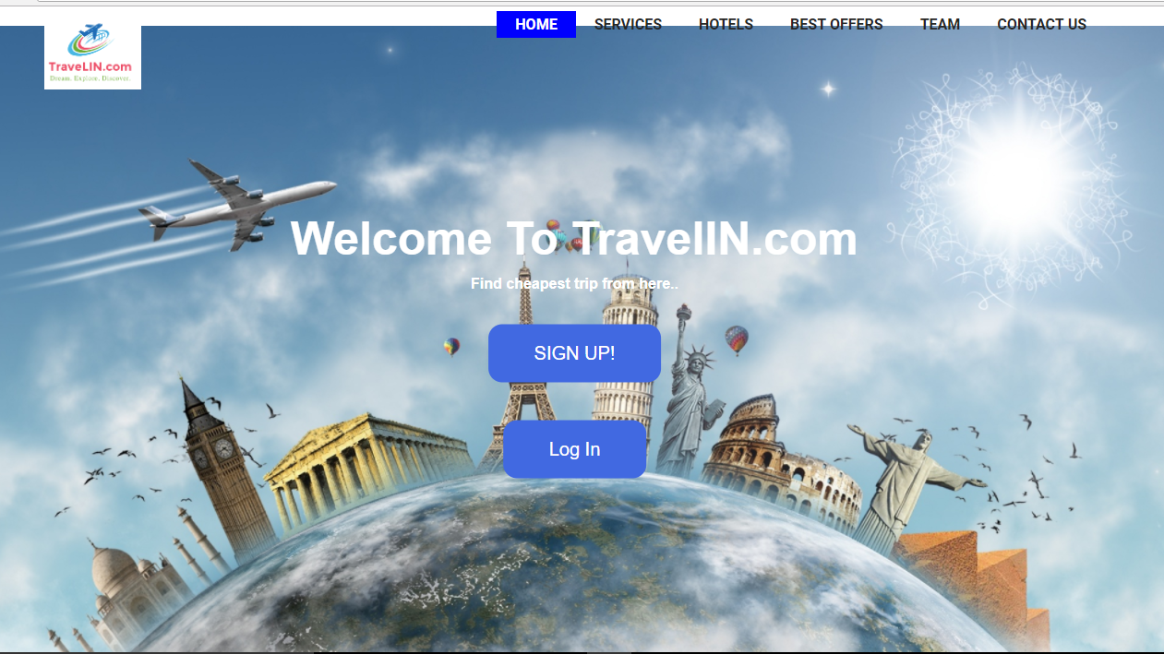
HOW IT GET STARTED…..

Slide 9
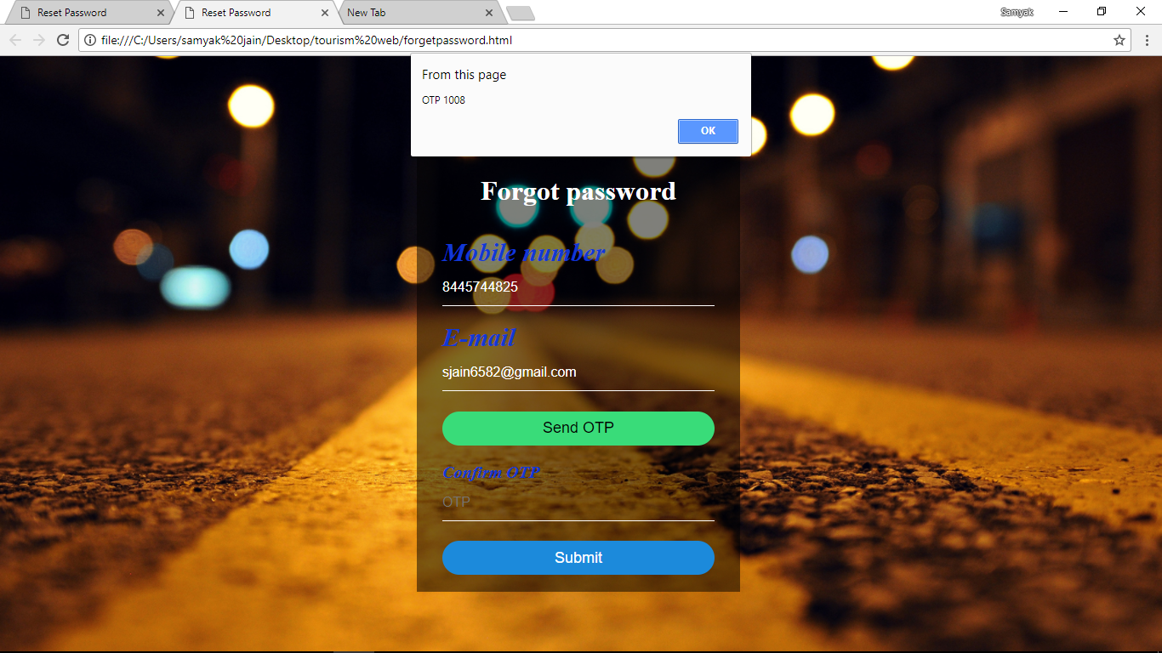
~FORGET PASSWORD~

Slide 10
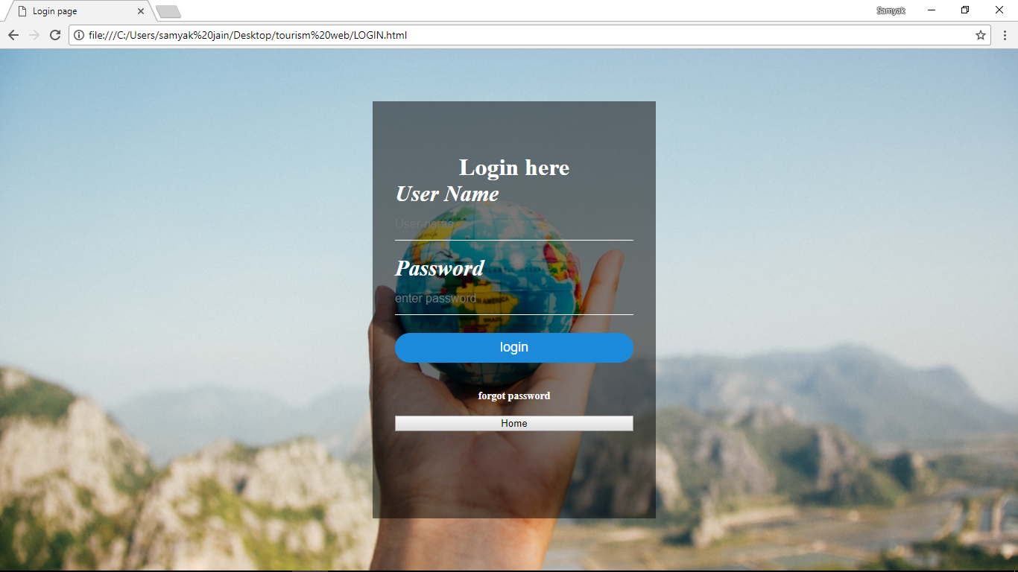
LOGIN PAGE FOR OUR OFFICIAL USERS:

Slide 11
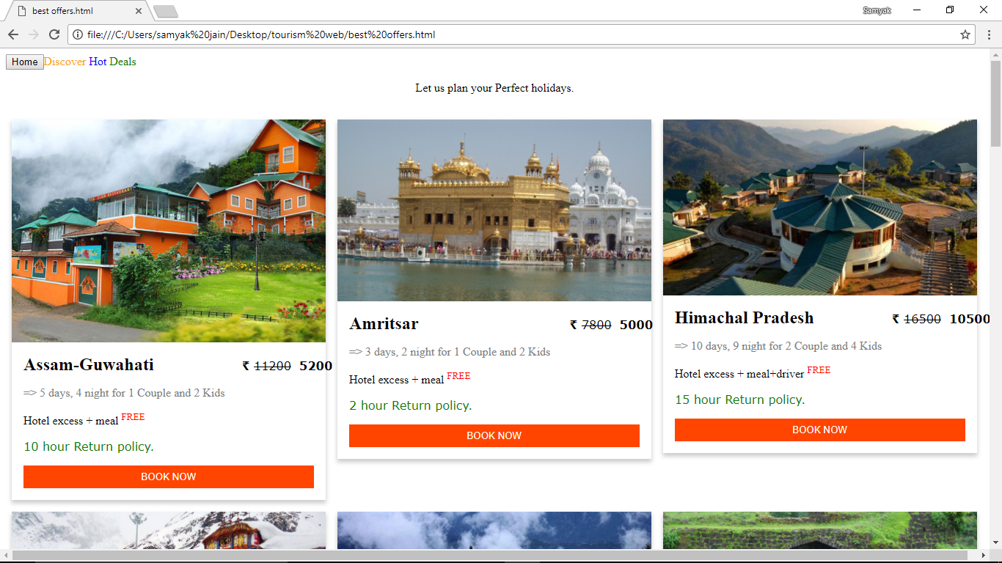
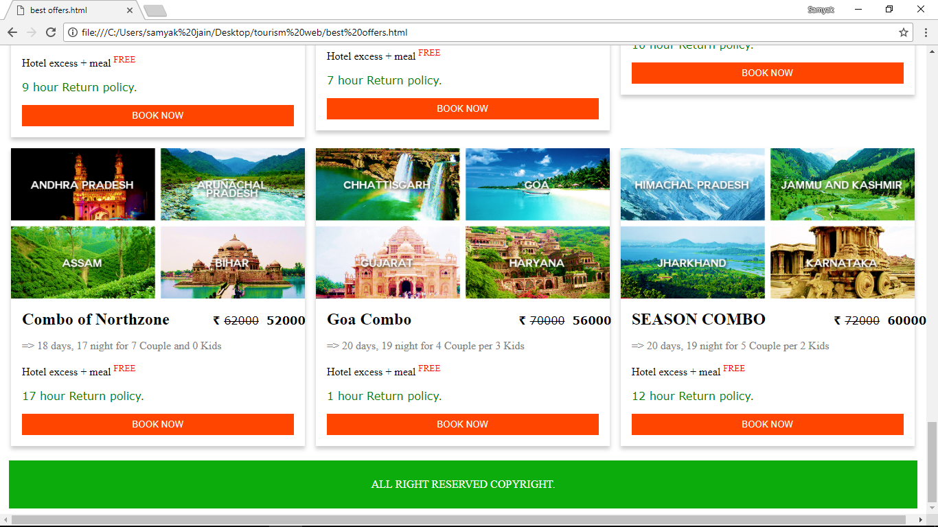
~BEST OFFERS~

Slide 12
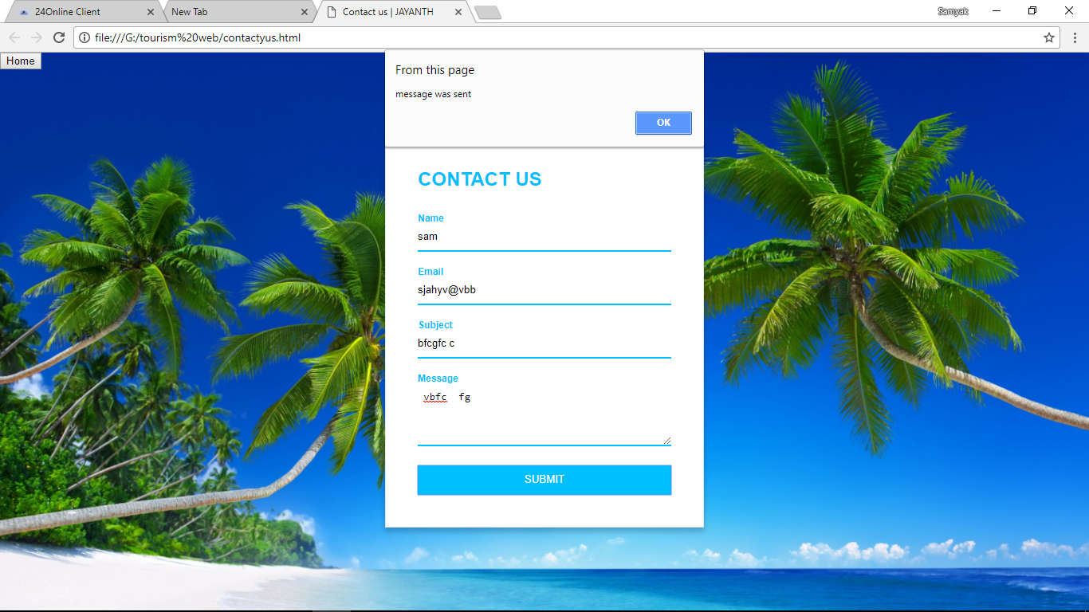
CONTACT US FOR MORE INFO

Slide 13
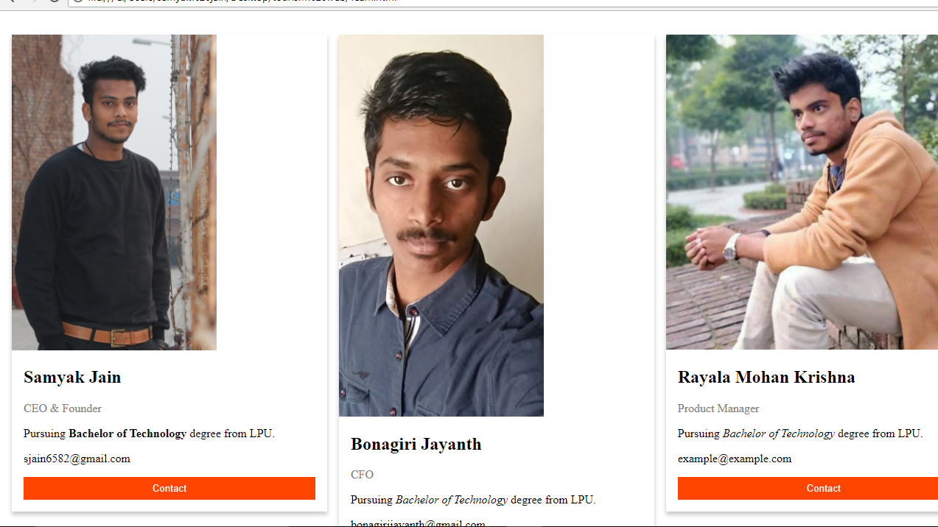
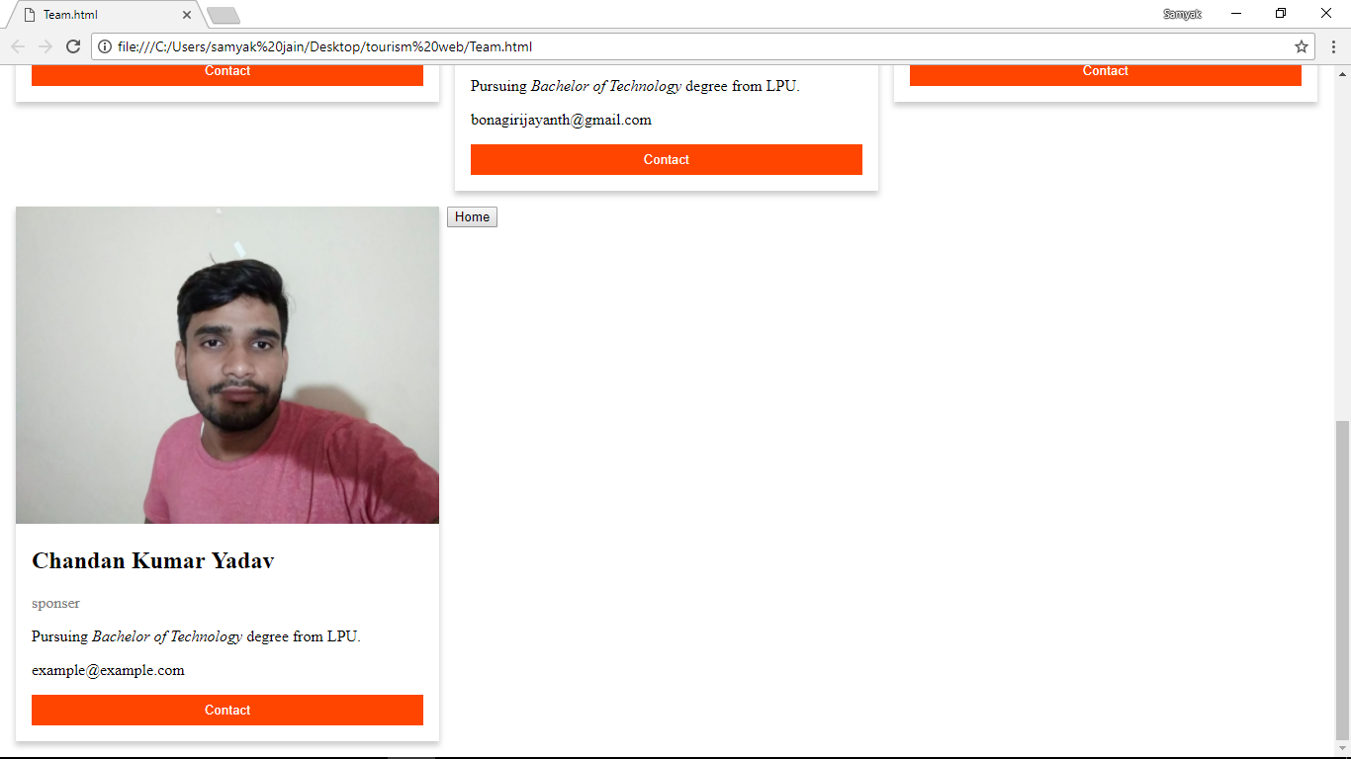
MEET OUR TEAM:

Slide 14
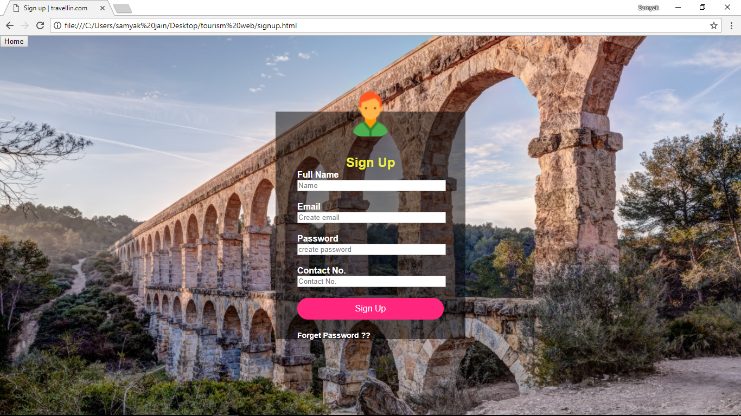
~SIGN UP FOR USERS~

Slide 15
CONCLUSION:
Has potential commercial benefits.
Can benefit to promote tourism in our country.
Succeeded in designing the project that we had originally proposed

Slide 16
Once a year ,
Go
Somewhere ,
You have
never
been before……

Slide 17
THANK
YOU…….

